Slide 1

DeployGuard — Repository Scanning & Deployment Orchestration
Project proposal by Hassan Sajjad (232460), Faria Fatima (233169), Tania Khawar (232378). Supervisor: Sir Yaseen Mushtaq — Air University, Department of Computer Science. A cloud-native platform that automates secure, cost-aware deployments for startups and SMEs.

Slide 2

INTRODUCTION
Why DeployGuard?
SMEs and startups lack accessible, repeatable cloud deployment processes. Manual deployments cause configuration drift, security gaps, and unpredictable cost spikes. DeployGuard provides a zero-configuration pipeline that maps repositories to validated infrastructure, enforces security gates, and offers an AI assistant to expedite troubleshooting.
Zero-configuration mapping from repo → optimized Docker template
Rule-based scanning to avoid AI hallucination in builds
Pre-deployment cost estimates and mandatory approvals

Slide 3


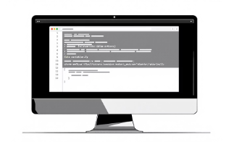
RELATED SYSTEMS
Raw AWS Console
Standard PaaS (e.g., Heroku)
Basic GitHub Actions
Weakness: steep learning curve for VPCs, ALBs, ECS. DeployGuard: abstracts AWS complexity and automates orchestration into the user's account.
Weakness: CI only—no IaC state locking or mandatory security gates. DeployGuard: integrates Terraform remote state locking and enforces Trivy scans pre-deploy.
Weakness: expensive at scale, limited cost transparency. DeployGuard: uses Fargate Spot and Infracost for transparent cost estimation and lower run-rates.

Slide 4

Problem Statement
Small teams face three core problems: (1) lack of accessible, secure orchestration leading to configuration errors and vulnerabilities; (2) no upfront cost visibility causing bill shock; (3) time-consuming failure diagnosis from opaque logs. DeployGuard solves these by automating safe builds, providing FinOps transparency, and delivering an LLM-assisted log remediation workflow.

Slide 5
Objectives — What DeployGuard Will Deliver
Zero-Configuration Deployments
Shift-Left Security
FinOps Transparency
Reliable IaC
Mandatory Aqua Trivy scans block critical/high vulnerabilities pre-deploy.
Infracost integration produces explicit monthly run-rate approvals before apply.
Terraform with S3 + DynamoDB remote state locking to prevent collisions.
Auto-detect stack and inject optimized Docker templates for reproducible builds.
AI Troubleshooting
LLM chatbot that ingests logs and provides pinpointed remediation steps in plain English.

Slide 6

System Architecture (High Level)
Repo & CI
Orchestration
GitHub triggers builds and links to DeployGuard frontend.
NestJS orchestrator queues jobs into Redis/BullMQ.
Preflight Checks
Provision & Run
Infracost estimate and Trivy scan gate queued artifacts.
Terraform (S3/DynamoDB lock) deploys to ECR → ECS Fargate.
Diagram caption: End-to-end flow from repository link → rule-based stack detection → pre-flight Infracost estimate → queued build/apply → Trivy gate → Terraform provisioning → ECS Fargate deployment with health checks and AI-assisted remediation.

Slide 7
Core Modules & Implementation Notes
Auth & Audit
Stack Detection Engine
CI/CD & Queuing
IaC & State
GitHub OAuth, RBAC (Admin/Dev/Read-only), immutable audit trail in PostgreSQL (TypeORM).
Redis + BullMQ for async jobs, GitHub Actions triggers, immutable commit-hash image tagging, ECR lifecycle policies.
Terraform modules for VPC, subnets, ALB, Cloud Map, remote state in S3 + DynamoDB locking.
NestJS service performing shallow clones and AST/file-signature scans to map to Docker templates.
Template & Validation
Monitoring & Rollbacks
Registry of distroless/alpine multi-stage Docker templates and JSON pre-flight reports for user review.
Prometheus telemetry, SSE streaming logs to UI, ALB /health checks, zero-downtime rollback to stable commit hash.

Slide 8

DevSecOps, FinOps & Resilience Features
Vulnerability Gates
Pre-Deploy Cost Approval
Trivy blocks Critical/High severities; detailed vulnerability dashboard with actionable fixes.
Infracost parses Terraform plan to present monthly run-rate and enforces explicit user approvals.
Spot Resilience
Data Safety
EventBridge spot interruption handling and instant replacement tasks to minimize disruption.
EFS for persistent storage, encrypted via KMS, and destroy workflows that explicitly preserve critical volumes.

Slide 9
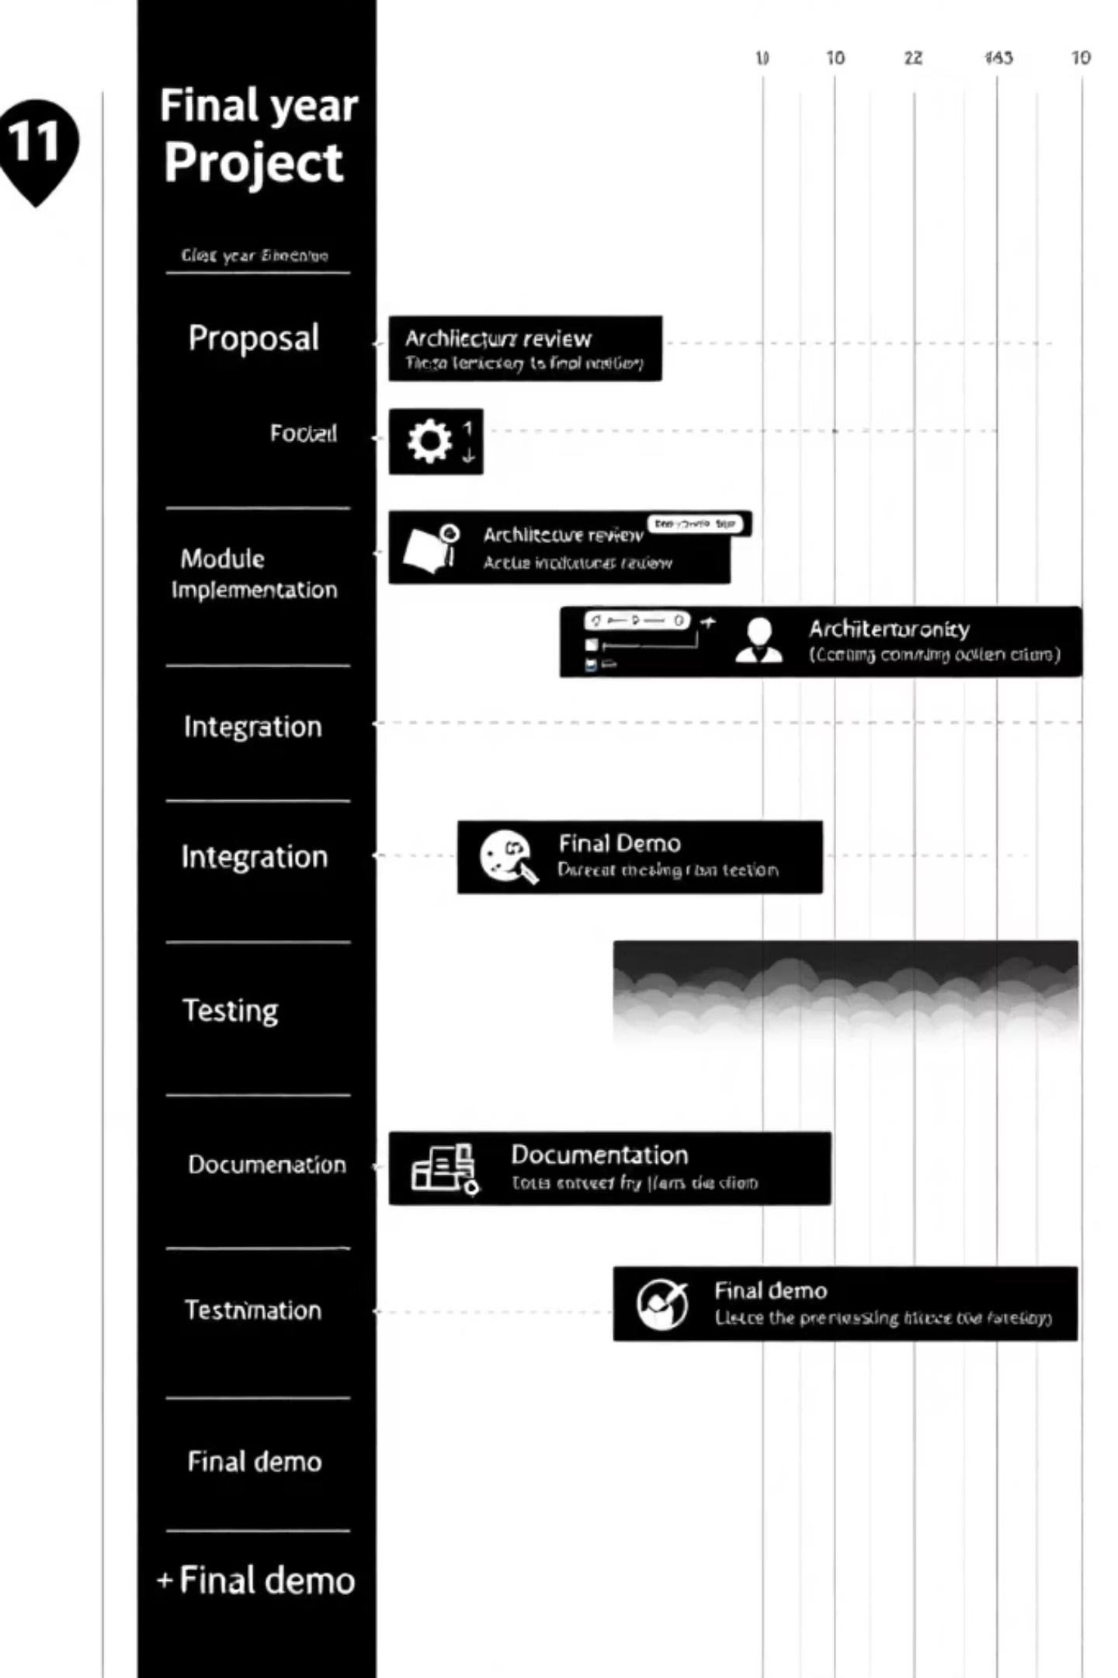
Project Plan & Deliverables
High-level milestones: proposal & feasibility → core module development (auth, detection, template engine) → CI/CD & IaC integration → Trivy & Infracost → AI chatbot & observability → end-to-end testing, documentation, final demo. Deliverables include source code, Terraform modules, Docker templates, test reports, and the scope document.

Slide 10

Limitations, Risks & Next Steps
Known Constraints
Next Steps
AWS-only Terraform modules — multi-cloud out of scope
Depends on GitHub-hosted repositories
Fargate Spot volatility may cause intermittent task preemptions
Finalize module assignments and detailed Gantt (immediate)
Prototype stack-detection + template injection (sprint 1)
Integrate Trivy scans and Infracost (sprint 2)
Build LLM log parser and dashboard chatbot (sprint 3)
End-to-end testing, supervisor review, and final report
Risks & Mitigations
State corruption risk — mitigated by S3+DynamoDB locking and strict job queueing
LLM hallucination for remediation — mitigated by constraining the chatbot to log parsing and reproducible suggestions only
Cost overruns — blocked by mandatory Infracost approval step
Supervisor meeting log: initial ideas, feasibility constraints, architecture review, AI troubleshooting, AWS limits — documented and reviewed with Sir Yaseen Mushtaq.
References: AWS Architecture Center; HashiCorp Terraform docs; Aqua Trivy; Infracost; project stakeholders: Air University & Final Year Project Committee.

